Slide 1
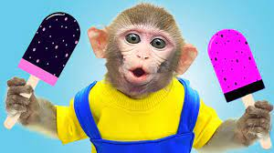
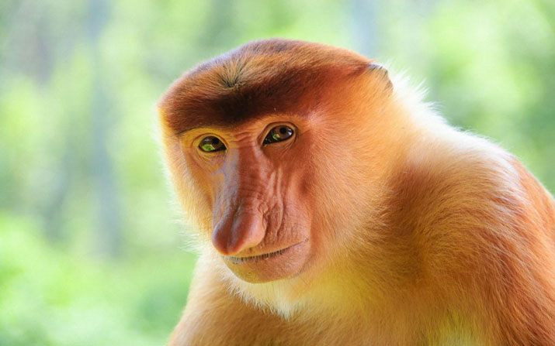
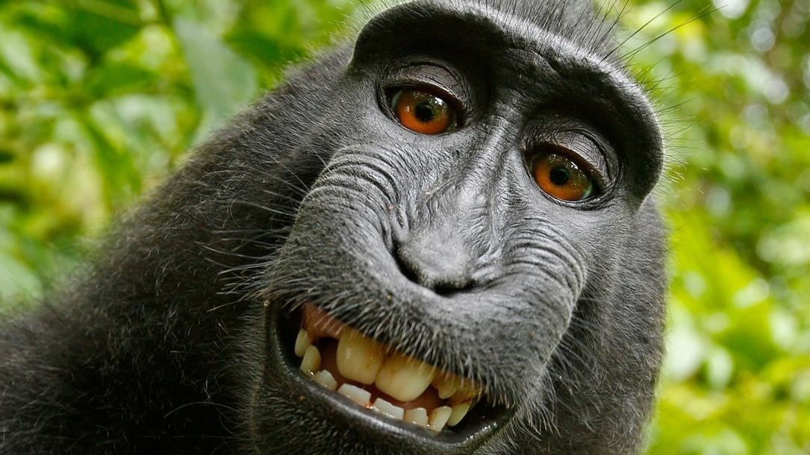
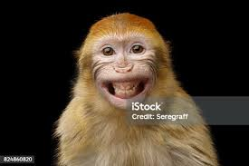
Hyper Log Log

Slide 2

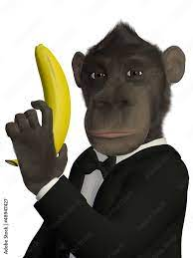
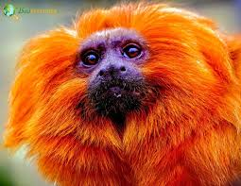
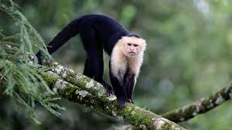
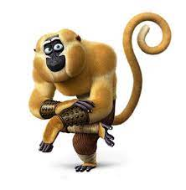
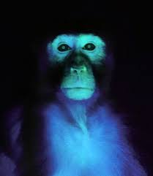

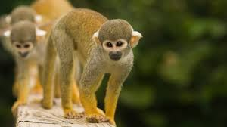
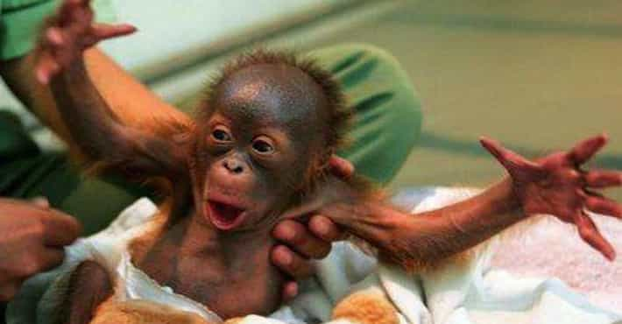
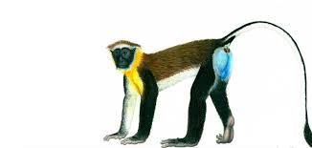

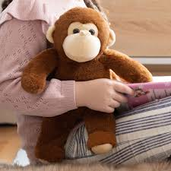

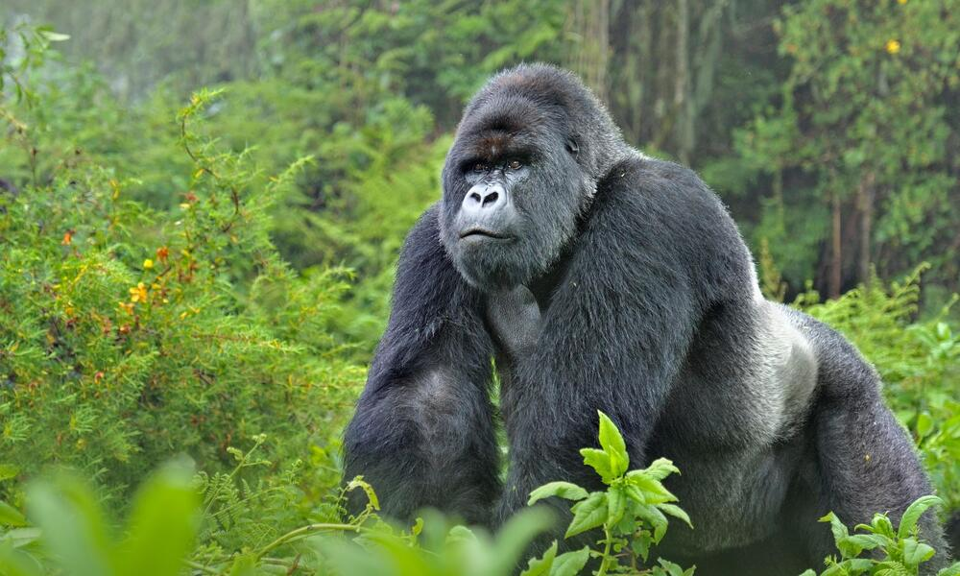
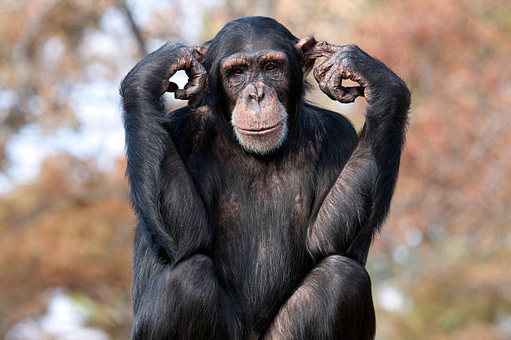
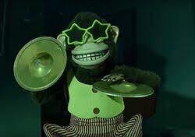
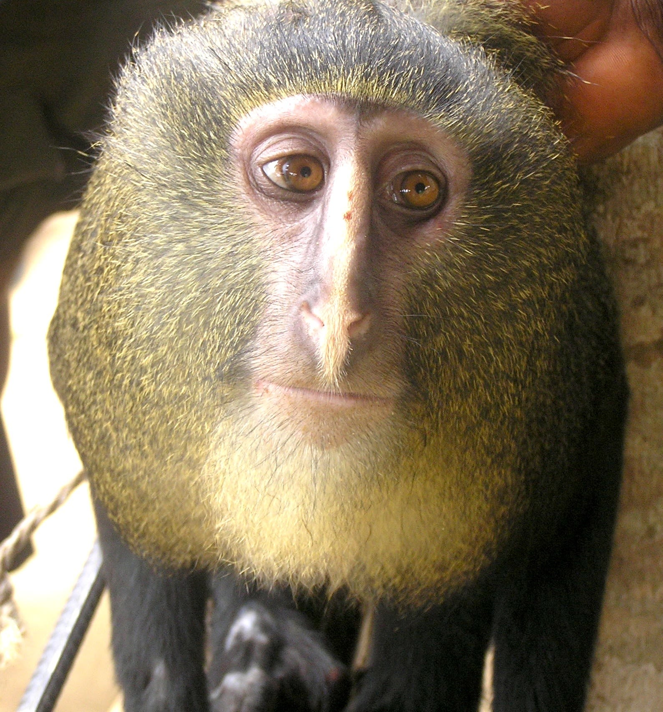

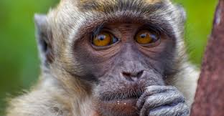
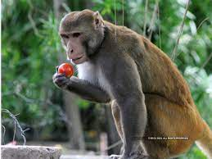
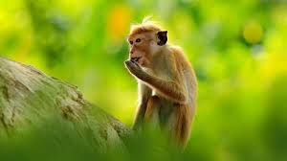
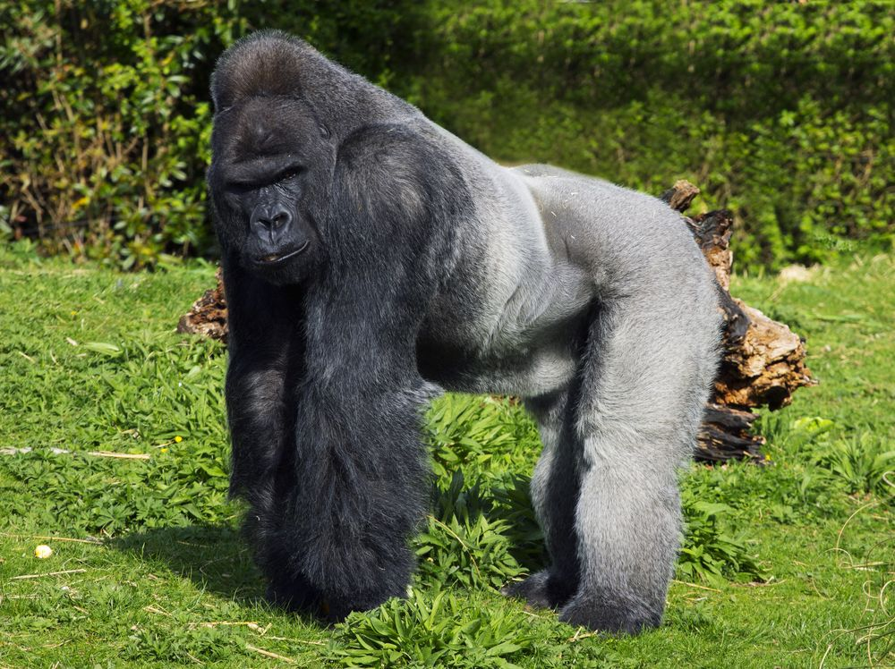
How many different types of monkeys are there?

Slide 3
Monkey Stack (sorted list, linked array, etc.)
Grabs monkey
Checks stack for identical monkeys
If no identical monkeys adds monkey to stack
Takes too long

Slide 4

Monkey Shelf (HashMap)
monkeys placed on the shelf are instantly sorted.
Slots for each monkey need to be configured beforehand
Takes too much storage

Slide 5
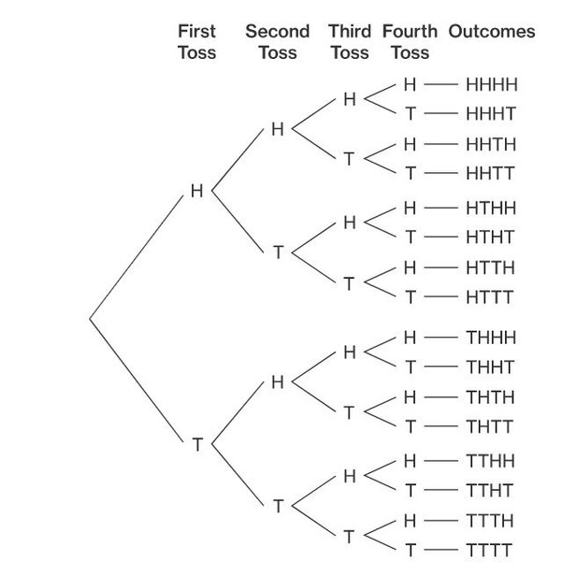
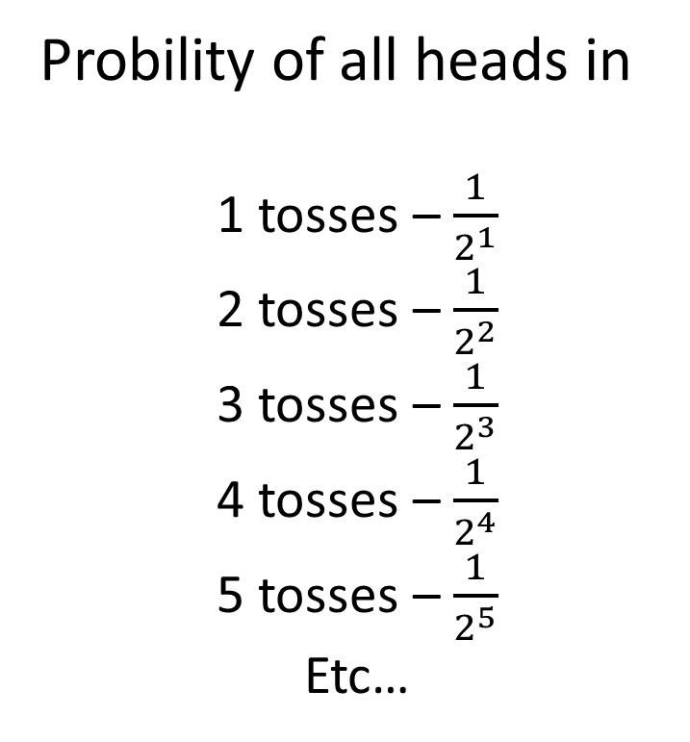
coinflips
Probility of all heads in
1 tosses – $\frac{1}{2^{1}}$
2 tosses – $\frac{1}{2^{2}}$
3 tosses – $\frac{1}{2^{3}}$
4 tosses – $\frac{1}{2^{4}}$
5 tosses – $\frac{1}{2^{5}}$
Etc…

Slide 6

Magic Monkey Meatgrinder(Hash Function)
Generates random binary sequence for each monkey
Will generate same set for same monkey
10100110101011011001
00100111101011011010
00100111101011011010

Slide 7
Magic Monkey Meatgrinder(Hash Function)
Run monkey through meat grinder
Count amount of zeros in a row
Repeat for every monkey and Keep track of highest amount of zeros on scorecard
4 zeros
10100110101011010000
4
2 zeros
01101010100001001100
4
7 zeros
01101010100010000000
7

Slide 8


Using scorecard to estimate monkeys scanned
$\frac{1}{2^{7}}$ chance of happening
01101010100010000000
7
We can aproximate that we scanned 128 different types of monkeys
$\frac{1}{2^{10}}$ chance of happening
11001110110000000000
10
We can aproximate that we scanned 1024 different types of monkeys

Slide 9

What if we just get unlucky?
1100110101000000000000000
15
7
index
15
2
Take harmonic mean off all scorecards
index
1100110101110101011101001
$$x=\frac{−b±\sqrt{b^{2}−4ac}}{2a}$$
0001110101110101011101010
1110110111000000000000000
1101110101110101011101000
index
2
index
1
0110110101111000100000110
1001110101110101011101010
7
1010110101111000101110110
0101110101110101001101000
7
1001110101110101011101011

